Slide 1
Data Modelling Project _ Adanri Awayewaserere Library Data Model

Slide 2
"A gateway to infinite knowledge."

Slide 3
Reason for choice of domain:
Ever since I was little, I’ve aways had a thing for reading books. My mother ran a bookstore and whenever I went to her store, I would spend hours getting lost in the pages of books. Over time, my opportunities to get physical books became fewer and fewer and I could only resort to e- books and web novels. However, whenever I get the chance, I read physical books. Nothing beats the magic of flipping through the pages and the smell of a new book. A library is home to many physical books hence my choice of domain.

Slide 4
A summary of the data the model should contain
A library has books
A library has patrons who come to use their services
A library has employees
A book has an author
A book is published by a publisher
A book can be borrowed from the library
A book can be loaned a library patron
A book can be reviewed by a user/patron
A book can be categorized under genres
Books loaned need to be returned

Slide 5
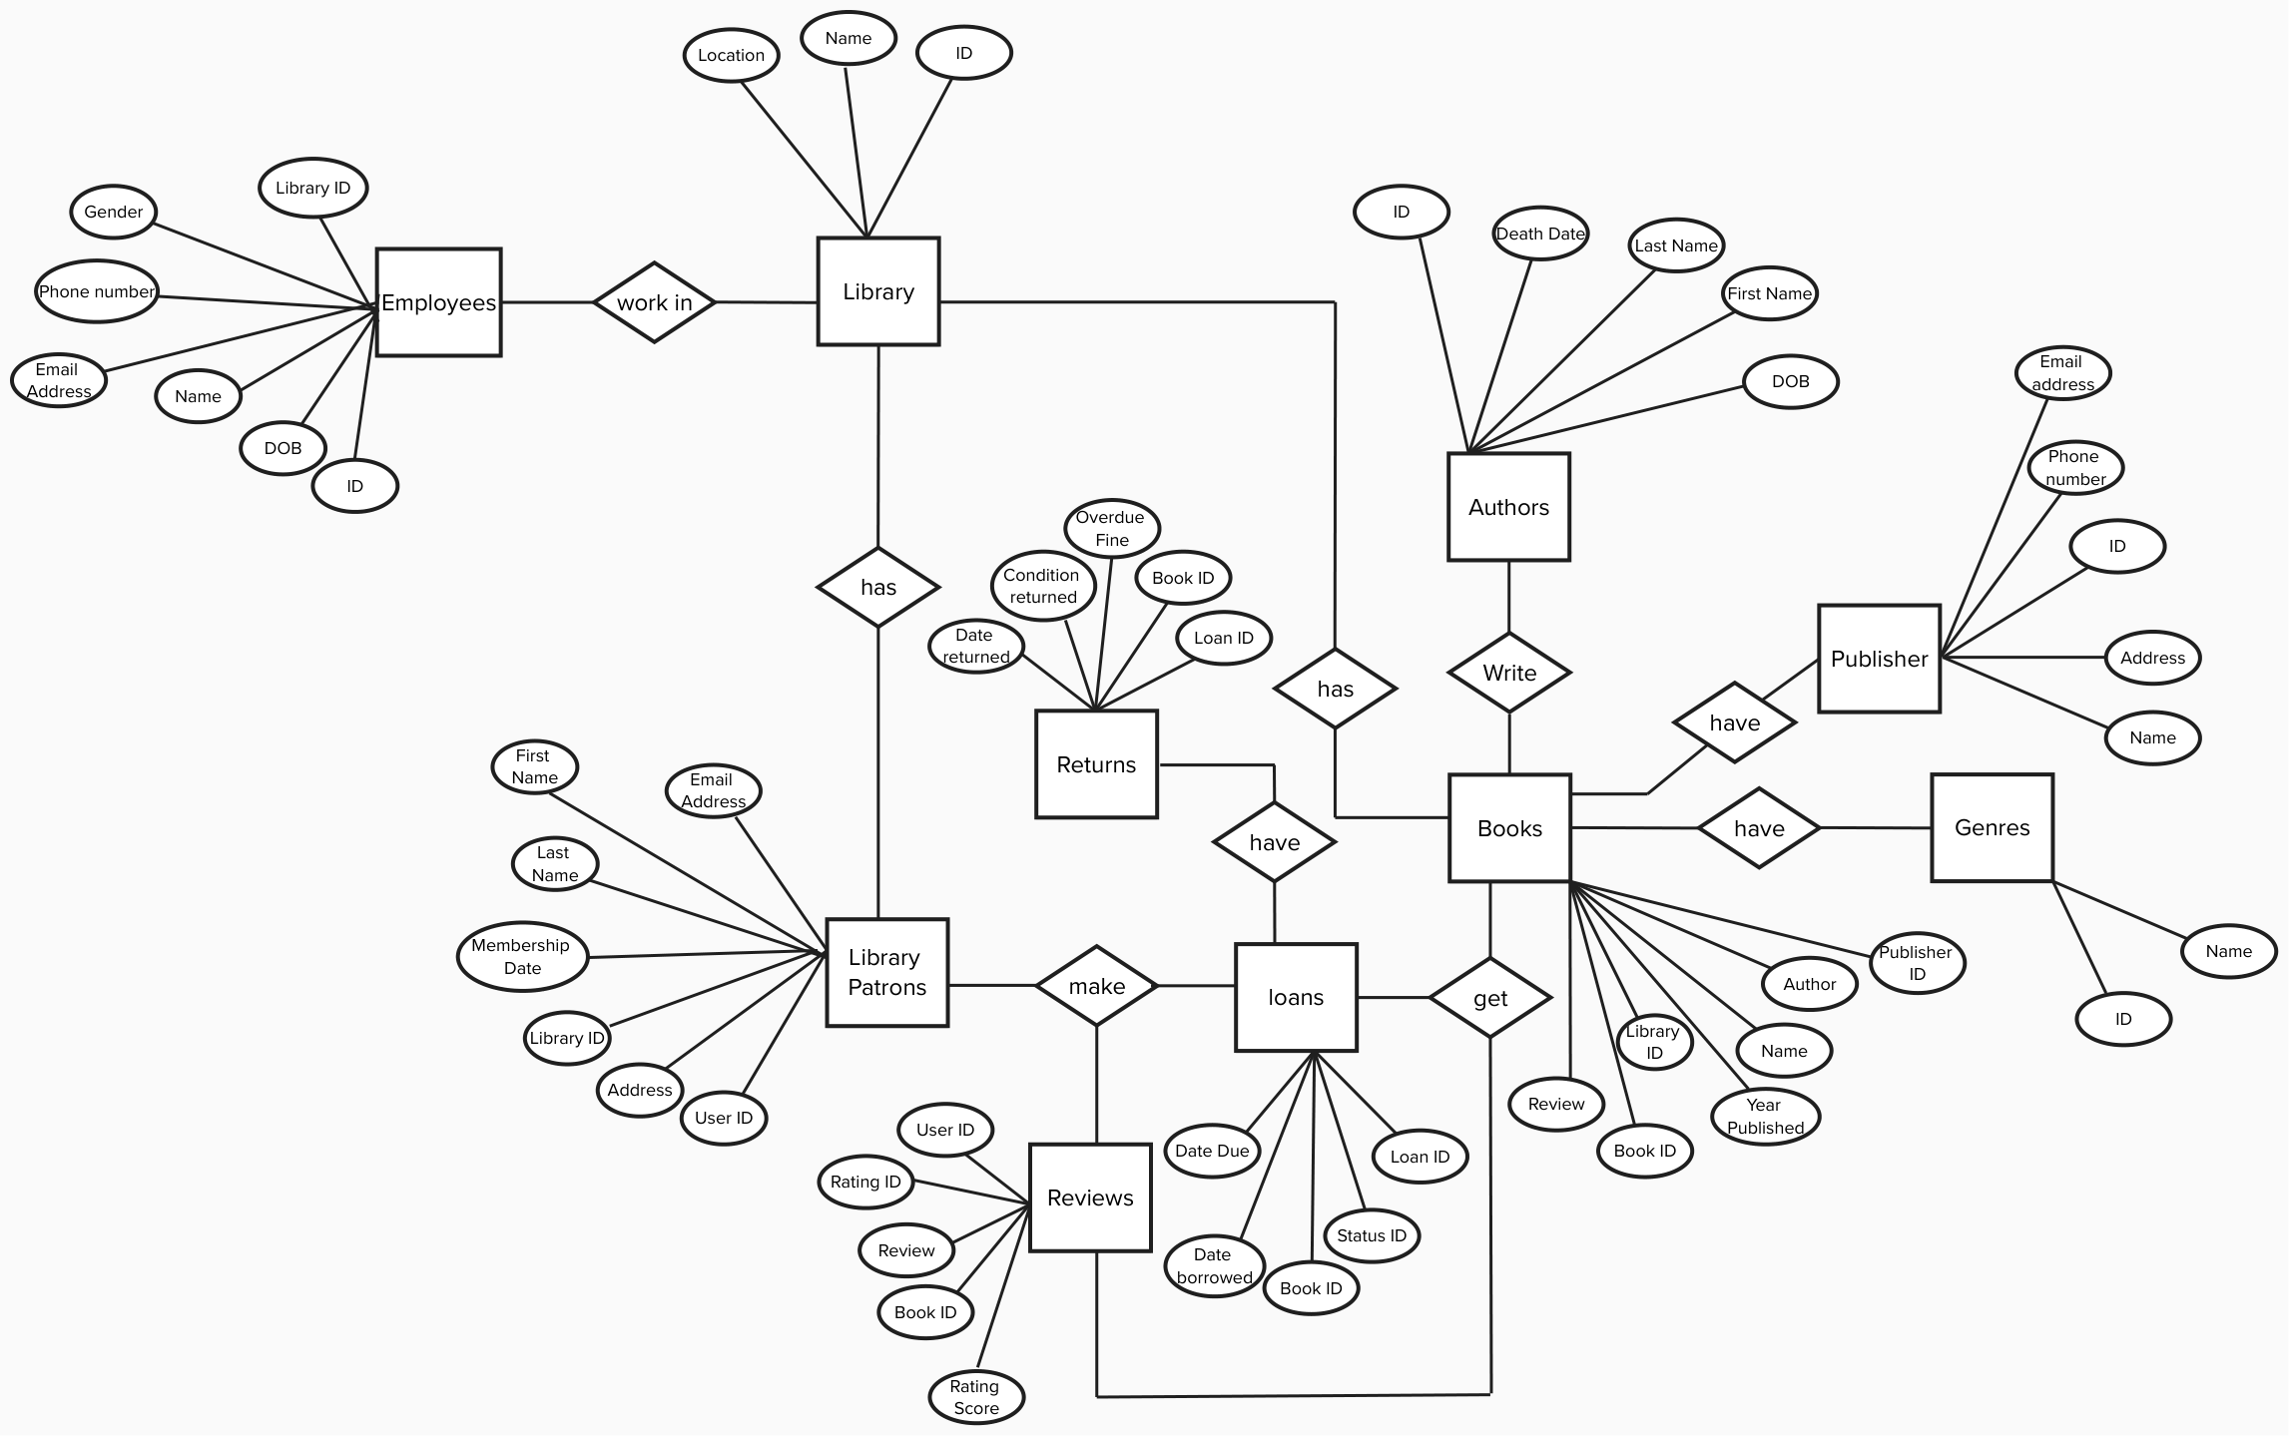
ER Diagram

Slide 6
Entities
Library
Employees
Books
Authors
Library patrons
Loans
Returns
Genres
Reviews
Publisher
Loan Status

Slide 7
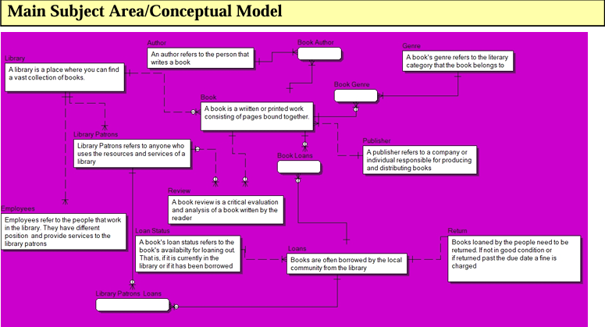
Conceptual Model

Slide 8
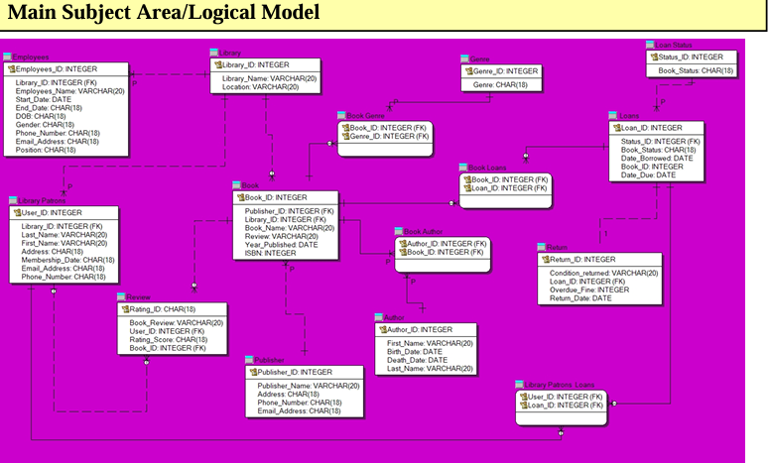
Logical Model

Slide 9
Relationships
Books and Authors (Many-to-Many): A single book can be written by multiple authors, and an author can write multiple books. I managed this relationship through a junction table (Book Author)
Books and Genres (Many-to-Many): A book can belong to multiple genres, and a genre can include multiple books. I managed this using a junction table (Book Genre) that links the Book and Genre tables.
Books and Publishers (One-to-Many): Each book is typically published by a single publisher, but a publisher can publish multiple books.
Library Patrons and Loans (Many-to-Many): A user can borrow multiple books, and a book can be borrowed by multiple users over time. I managed this using a junction table (Library patron Loans) that links the Library Patrons and Loan tables.
Books and Reviews (One-to-Many): Each book can have multiple reviews, but each review is associated with a single book.
Employees and Library (One-to-Many): Each library can have multiple employees, but each employee is associated with a single library.
Books and Loans (Many-to-Many): A single book can be loaned out multiple times to different users, and a single user can loan multiple books.
Loans and Returns (One-to-One): Each loan record corresponds to a single return record.
Library Patrons and Reviews (One-to-Many): Each library patron can write multiple reviews, but each review is associated with a single patron.

Slide 10
Key Choices and Relationships
Book Table
Primary Key: Book ID
A unique identifier for each book in the library.
Foreign Key: Publisher ID
Links each book to its publisher.
Author Table
Primary Key: Author ID
A unique identifier for each author.
Publisher Table
Primary Key: Publisher ID
A unique identifier for each publisher.
Library Patron Table
Primary Key: User ID
A unique identifier for each library patron.
Loan Table
Primary Key: Loan ID
A unique identifier for each loan record.
Foreign Keys: Status ID
links the loan record to the Loan Status table, indicating the status of the loan.
Genre Table
Primary Key: Genre ID
A unique identifier for each genre.
Loan Status Table
Primary Key:
Status id: This uniquely identifies each entry in the Loan Status table.
Foreign Key:
Loan id: This links the Loan Status table to the Loans table, ensuring that each status update corresponds to a specific loan.
Returns Table
Primary Key: Return ID
A unique identifier for each return record.
Foreign Key: Loan ID
Links each return record to the corresponding loan record.
Review Table
Primary Key: Review ID
A unique identifier for each review.
Foreign Keys:
Book ID: Associates each review with a specific book.
User ID: Associates each review with a specific user.
Book Loan Junction Table
Primary Keys: Book ID, Loan ID
Links each entry to a specific book and loan.
Library Patron Loan Junction Table
Primary Keys: Loan ID, User ID
Links each entry to a specific library patron and loan.
Book Author Junction Table
Primary Keys: Book ID, Author ID
Links each entry to a specific book and author.
Book Genre Junction Table
Primary Keys: Book ID, Genre ID
Links each entry to a specific book and genre.

Slide 11
CHALLENGES
While creating this model, I had issues with data redundancy. I repeated the same attributes in different entities. I had to fully familiarize myself with the term data redundancy and avoid it by defining foreign keys.
While creating this model, I also had issues with managing relationships. I had to make sure that every relationship I created was relevant to the model and I spent quite a lot of time taking out irrelevant relationships.
This model also required me to think critically about how a library is run. I had considered every activity that happens in the library and picked out the most important ones. Some entities in this model were added later in the project e.g., returns entity, loan status entity.

Slide 12
Thank you
Adanri Awayewaserere
adanriawayewaserere@gmail.com

